Slide 1
Business Intelligence
Introduction

Slide 2
Introductions
I am Elisavet (Elly) Andrikopoulou PhD, MRes, Bsc, BA, TMIET, MBCs
You can find me at:
Email: elisavet.andrikopoulou@port.ac.uk
Twitter: @Prayance
Discord: Prayance#2663
If you add me as friend please send me a message saying I am this person, your student in this module :)

Slide 3
And you ... are?
Tell us your:
Name
What do you hope to learn in this unit
What are your educational or work-related future plans

Slide 4
Expectations
Every week I expect you to read and watch the material on Moodle.
You have the workshops to ask questions about those.
During the workshop I expect you to have an understanding of the week’s material on Moodle.
During the workshop we will work on the group tasks, on the coursework and on either SQL or Tableau (depending on the week).
The lecture will cover theoretical concepts.

Slide 5
What is Business Intelligence
Business Intelligence (BI) refers to technologies, applications and practices for the collection, integration, analysis, and presentation of business information.
Business intelligence (BI) is an umbrella term that includes the applications, infrastructure and tools, and best practices that enable access to and analysis of information to improve and optimize decisions and performance.
Business intelligence is the process of using data to power business decisions to enable greater efficiencies across the organisation.

Slide 6
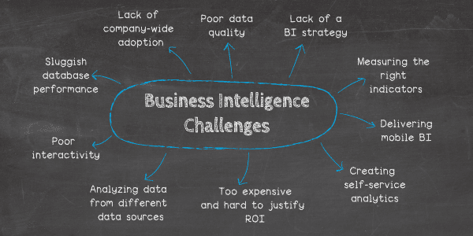
BI challenges

Slide 7
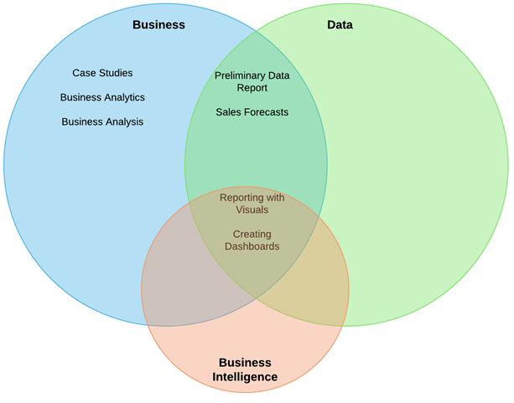
Where does it fit?

Slide 8
Analysis vs analytics
Analysis : Detailed examination of the elements or structure of something, typically as a basis for discussion or interpretation
Analytics : The systematic computational analysis of data or statistics.
Data Analytics: Using statistics and data science tools to analyze data.
Data Analysis : Data Analysis is a broader term and includes Data Analytics.
Using statistics, with or without the aid of computerized tools, to analyze data.

Slide 9
BI insights: Accurate
If what goes in is not accurate, what comes out won’t be either and…
It has the potential to be even less accurate
The actions taken may exaggerate the inaccuracies
The actions need to be accurate and trustworthy

Slide 10
BI insights: Valuable
Stores such as Tesco look for things we buy together
It is no good making assumptions that if we buy cheese we will buy nappies.
If we buy cheese we may buy bread or we may buy crackers. (But not Christmas crackers)
The thing about BI is the ability to link together data that might not be obvious.

Slide 11
BI insights: On-time
Delays in gaining accurate and valuable data can make it useless.
Think back to the earlier clothing store scenario.
It’s no good finding out in September that the best time to start to sell the new clothing range is in July!

Slide 12
BI insights: Actionable
What if you find out that people want to buy cheese and carpet?
OK if you sell cheese and carpets but not a lot of use if you don’t.
So the BI results need to be of use to the actual business they are being obtained for!

Slide 13
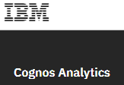







Business intelligence tools
There are many BI platforms available for:
ad hoc reporting
data visualization
creating customized dashboards for multiple levels of users.

Slide 14
Connect to the Databases
Follow the instructions:
https://moodle.port.ac.uk/mod/url/view.php?id=1449419
Let me know when you are done and if you have problems!

Slide 15
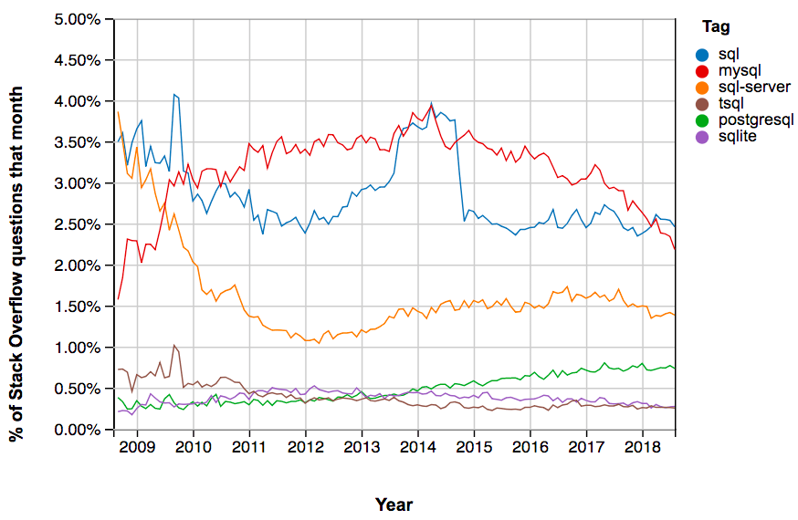
What SQL?
SQL, or Structured Query Language, is the standard language for interacting with relational databases.

Slide 16
Syntax differences | SQL Server | MySQL | PostgreSQL | SQLite
SELECT ... | Select [col1], [col2] | SELECT col1, col2 | SELECT col1, col2 | SELECT col1, col2
Data from tables is case sensitive? | Yes WHERE name = ‘John’ Or WHERE name = ‘john’ are not the same | No WHERE name = ‘John’ Or WHERE name = ‘john’ are the same | Yes WHERE name = ‘John’ Or WHERE name = ‘john’ are not the same | Yes WHERE name = ‘John’ Or WHERE name = ‘john’ are not the same
Using quotation marks | name = ‘John’ only | name = ‘John’ or name = “John” | name = ‘John’ only | name = ‘John’ or name = “John”
Aliases for columns and tables | SELECT AVG(col1)=avg1 | SELECT AVG(col1) AS avg1 | SELECT AVG(col1) AS avg1 | SELECT AVG(col1) AS avg1
Working with dates | GETDATE() DATEPART() | CURDATE() CURTIME() EXTRACT() | CURRENT_DATE() CURRENT_TIME() EXTRACT() | DATE(‘now’) strftime()
Window functions i.e., OVER(), PARTITION BY() | Yes | Yes | Yes | No (need to use subqueries instead)

Slide 17
Some SQL
Make sure you are connected to the HappyBakery data warehouse.
Find all the tables.
Query the dimProduct table.
Find all the product names that are croissants.
Query the FactSales table.
SELECT * FROM HappyBakery.INFORMATION_SCHEMA.TABLES;
SELECT * FROM DimProduct;
SELECT * FROM DimProduct Where ProductType = 'Croissant';
SELECT * FROM FactSales;

Slide 18
Some SQL
Make sure you are connected to the HappyBakery data warehouse.
Find all the Sales of the product code 23.
Find the product name of the product code 23.
List all the sales and products with the categoryID = 2
SELECT * FROM FactSales Where ProductCode = 20;
SELECT ProductName FROM DimProduct Where ProductCode = 20;
SELECT * FROM FactSales inner join DimProduct on DimProduct.ProductCode = FactSales.ProductCode Where CategoryID = 2;

